Slide 1
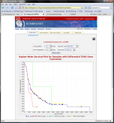
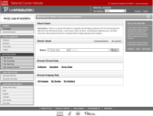
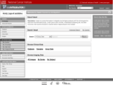
CaIntegrator2 Overview
Array Data
Project Team
Public
Software Development Team
Project Team
Clinical Data
Rembrandt (for example)
Imaging Data
caIntegrator (old)
Process repeated again for each project, reusing code and developer expertise.
caIntegrator2 (new)
Project Team
Public
Study Manager
Software Development Team
View Study
caIntegrator2
Deploy Study
Array Data
caArray
Project Team
Clinical Data
TBD
Images
NCIA
Image Annotations
TBD

Slide 2
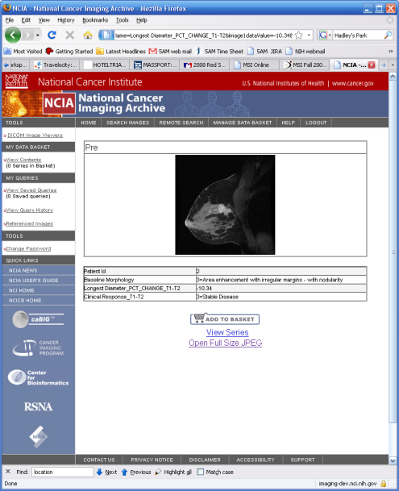
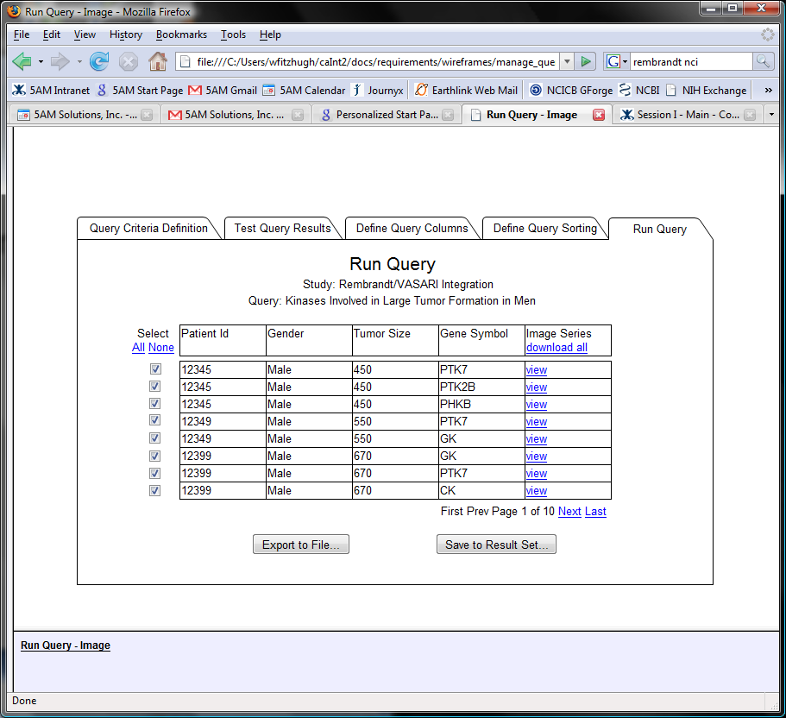
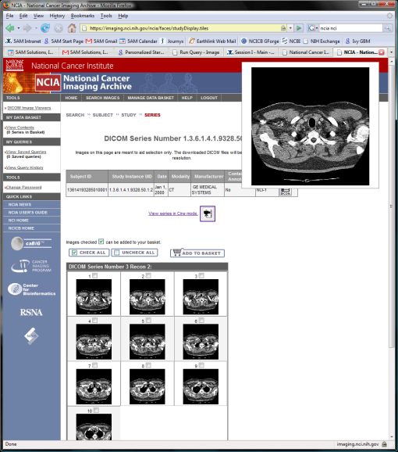
Current Plans for Image Viewing

